Slide 1
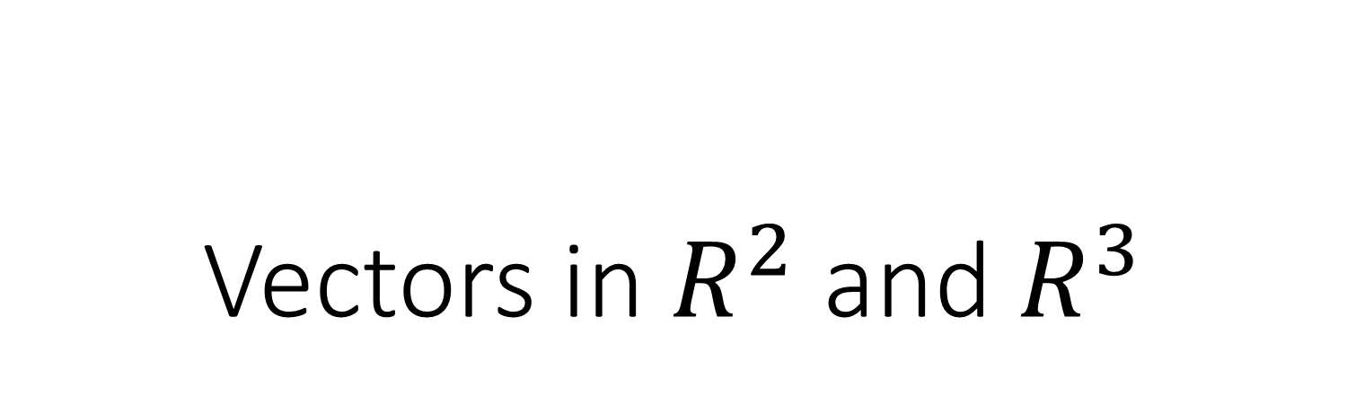
Vectors in $R^{2}$ and $R^{3}$

Slide 2
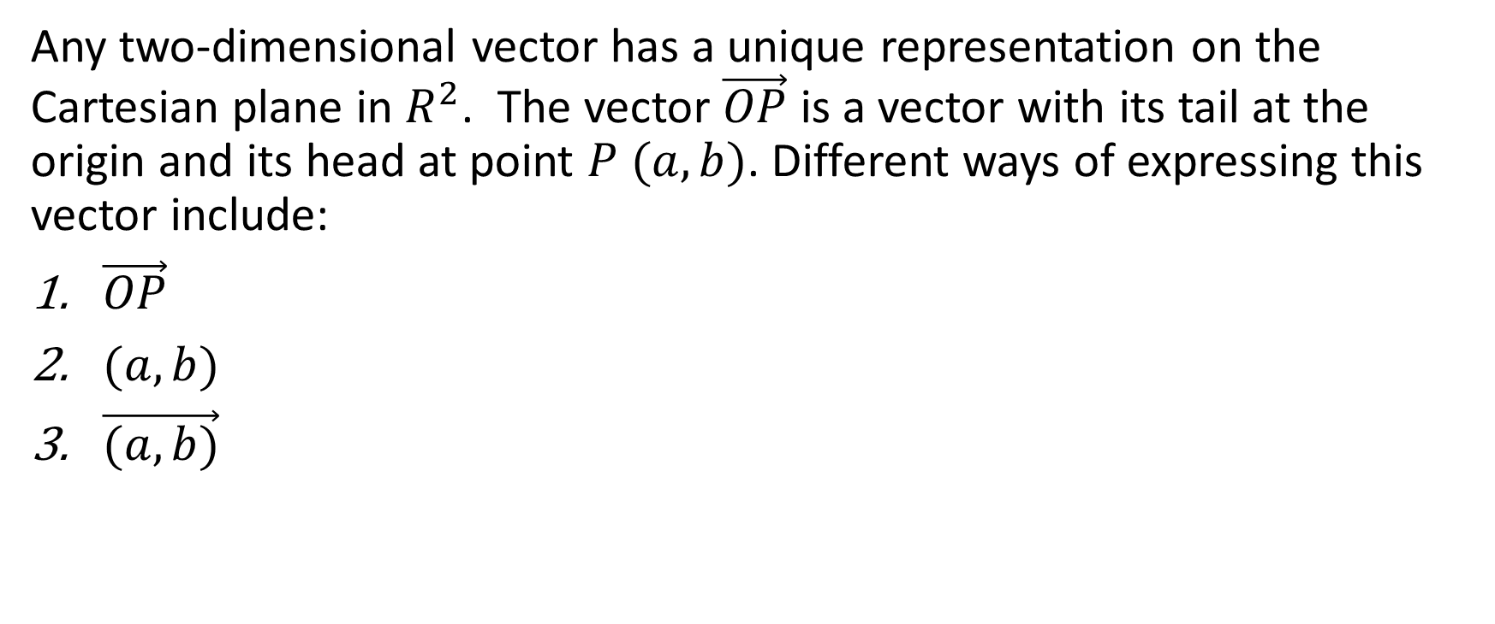
Any two-dimensional vector has a unique representation on the Cartesian plane in $R^{2}$. The vector $\vec{OP}$ is a vector with its tail at the origin and its head at point $P (a,b)$. Different ways of expressing this vector include:
$\vec{OP}$
$(a, b)$
$\vec{(a, b)}$

Slide 3
Any two-dimensional vector has a unique representation on the Cartesian plane in $R^{2}$. The vector $\vec{OP}$ is a vector with its tail at the origin and its head at point $P (a,b)$. Different ways of expressing this vector include:
$\vec{OP}$
$(a, b)$
$\vec{(a, b)}$
.
(a, b)

Slide 4
Any two-dimensional vector has a unique representation on the Cartesian plane in $R^{2}$. The vector $\vec{OP}$ is a vector with its tail at the origin and its head at point $P (a,b)$. Different ways of expressing this vector include:
$\vec{OP}$
$(a, b)$
$\vec{(a, b)}$
.
(a, b)

Slide 5
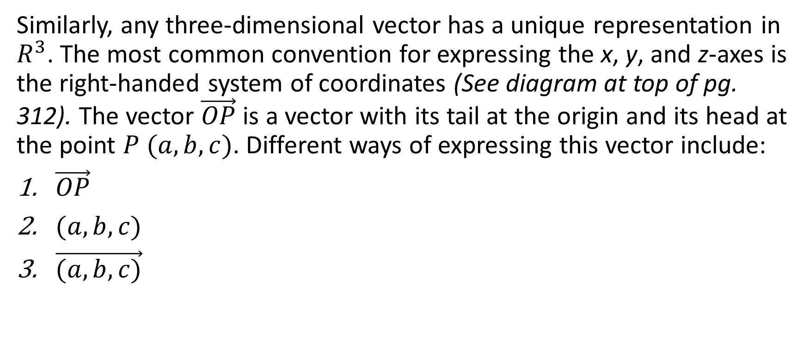
Similarly, any three-dimensional vector has a unique representation in $R^{3}$. The most common convention for expressing the x, y, and z-axes is the right-handed system of coordinates (See diagram at top of pg. 312). The vector $\vec{OP}$ is a vector with its tail at the origin and its head at the point $P (a,b,c)$. Different ways of expressing this vector include:
$\vec{OP}$
$(a, b,c)$
$\vec{(a, b,c)}$

Slide 6

Example: Using the right-handed system, sketch the vector $\vec{OP}$where the coordinates of point P are (6,2,4).

Slide 7


Example: Using the right-handed system, sketch the vector $\vec{OP}$where the coordinates of point P are (6,2,4).
Solution:

Slide 8
Example: Using the right-handed system, sketch the vector $\vec{OP}$where the coordinates of point P are (6,2,4).
Solution:

Slide 9
Example: Using the right-handed system, sketch the vector $\vec{OP}$where the coordinates of point P are (6,2,4).
Solution:

Slide 10
Example: Using the right-handed system, sketch the vector $\vec{OP}$where the coordinates of point P are (6,2,4).
Solution:

Slide 11
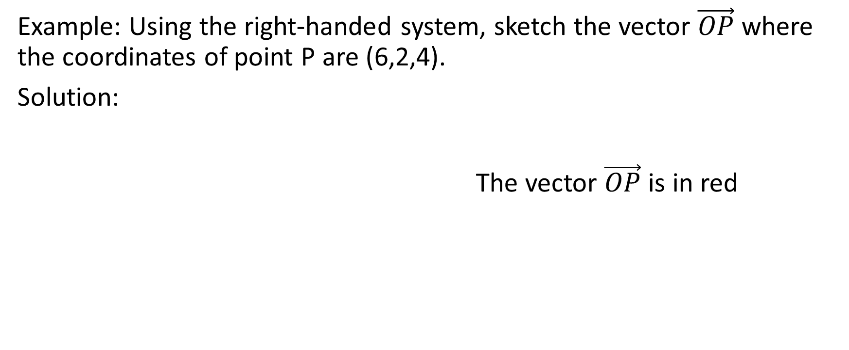
Example: Using the right-handed system, sketch the vector $\vec{OP}$where the coordinates of point P are (6,2,4).
Solution:
The vector $\vec{OP}$ is in red

Slide 12

Example: Using the right-handed system, sketch the vector $\vec{OP}$where the coordinates of point P are (6,2,4).
Solution: Determine the coordinates of
the points O, A, B, C, D, E, F, P

Slide 13

Example: Using the right-handed system, sketch the vector $\vec{OP}$where the coordinates of point P are (6,2,4).
Solution:
O (0,0,0)

Slide 14

Example: Using the right-handed system, sketch the vector $\vec{OP}$where the coordinates of point P are (6,2,4).
Solution:
O (0,0,0) A (0,2,0)

Slide 15
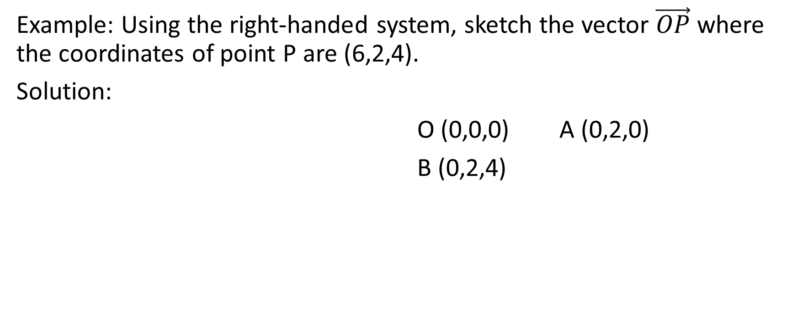
Example: Using the right-handed system, sketch the vector $\vec{OP}$where the coordinates of point P are (6,2,4).
Solution:
O (0,0,0) A (0,2,0)
B (0,2,4)

Slide 16
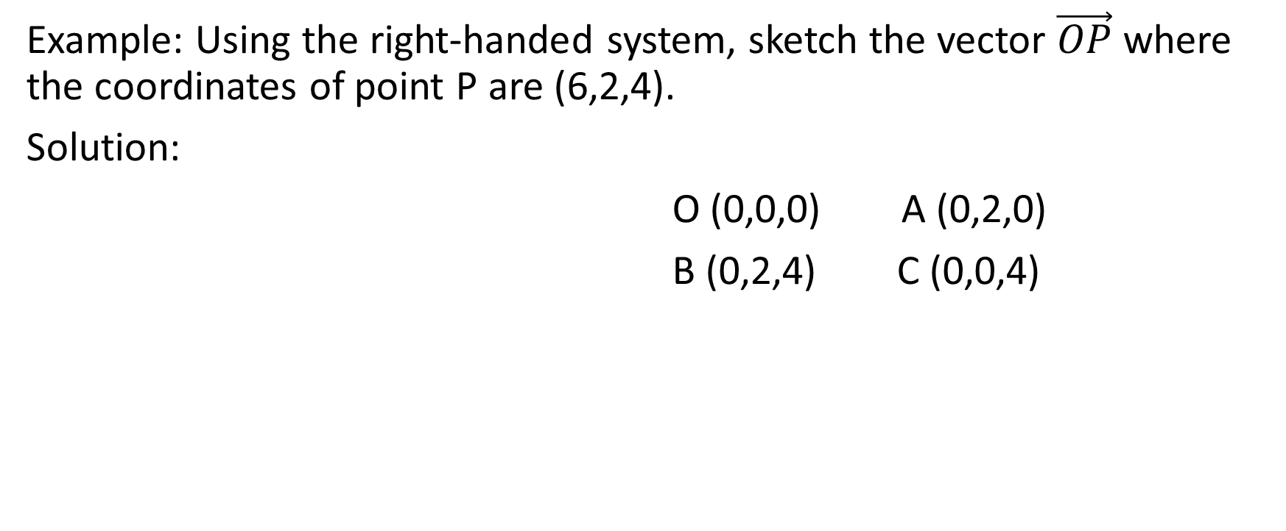
Example: Using the right-handed system, sketch the vector $\vec{OP}$where the coordinates of point P are (6,2,4).
Solution:
O (0,0,0) A (0,2,0)
B (0,2,4) C (0,0,4)

Slide 17
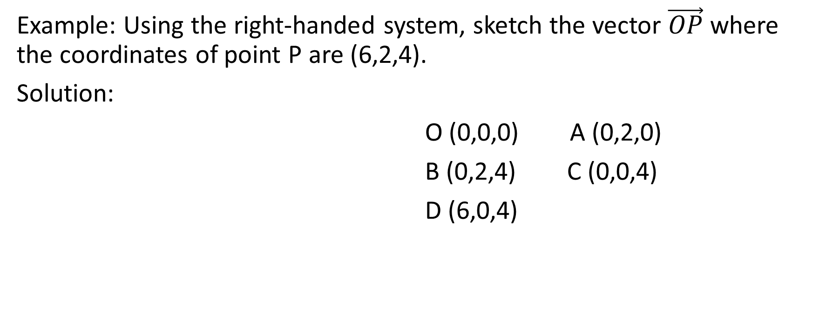
Example: Using the right-handed system, sketch the vector $\vec{OP}$where the coordinates of point P are (6,2,4).
Solution:
O (0,0,0) A (0,2,0)
B (0,2,4) C (0,0,4)
D (6,0,4)

Slide 18
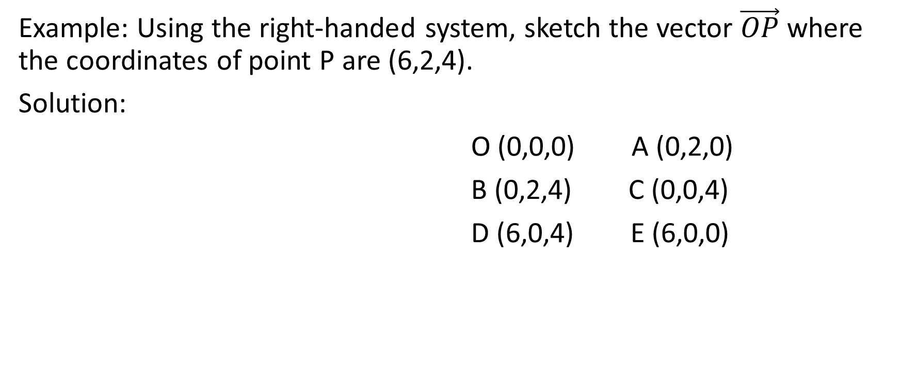
Example: Using the right-handed system, sketch the vector $\vec{OP}$where the coordinates of point P are (6,2,4).
Solution:
O (0,0,0) A (0,2,0)
B (0,2,4) C (0,0,4)
D (6,0,4) E (6,0,0)

Slide 19
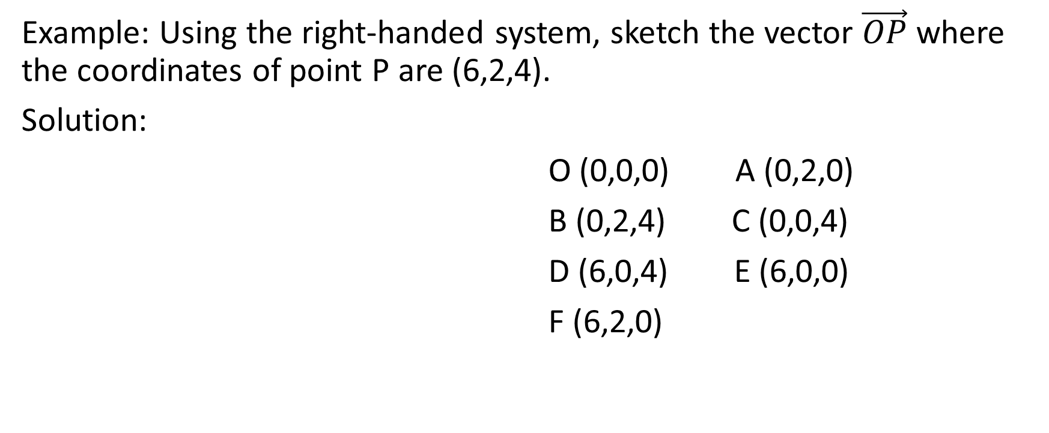
Example: Using the right-handed system, sketch the vector $\vec{OP}$where the coordinates of point P are (6,2,4).
Solution:
O (0,0,0) A (0,2,0)
B (0,2,4) C (0,0,4)
D (6,0,4) E (6,0,0)
F (6,2,0)

Slide 20
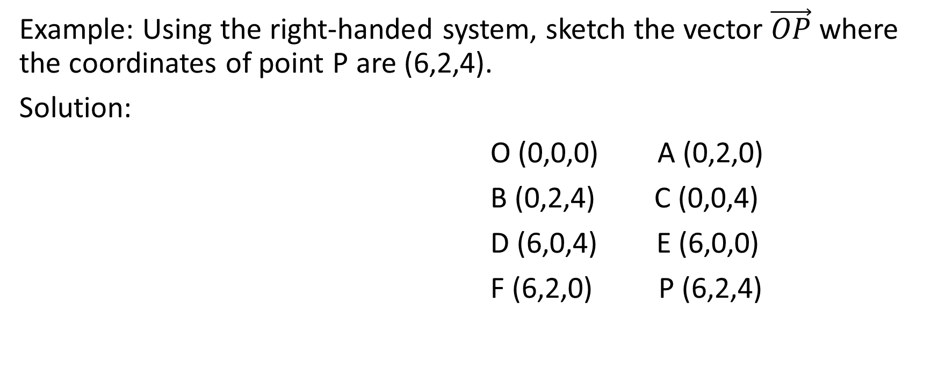
Example: Using the right-handed system, sketch the vector $\vec{OP}$where the coordinates of point P are (6,2,4).
Solution:
O (0,0,0) A (0,2,0)
B (0,2,4) C (0,0,4)
D (6,0,4) E (6,0,0)
F (6,2,0) P (6,2,4)

Slide 21


Example: Using the right-handed system, sketch the vector $\vec{OP}$where the coordinates of point P are (-2,1,-5).
Solution:

Slide 22
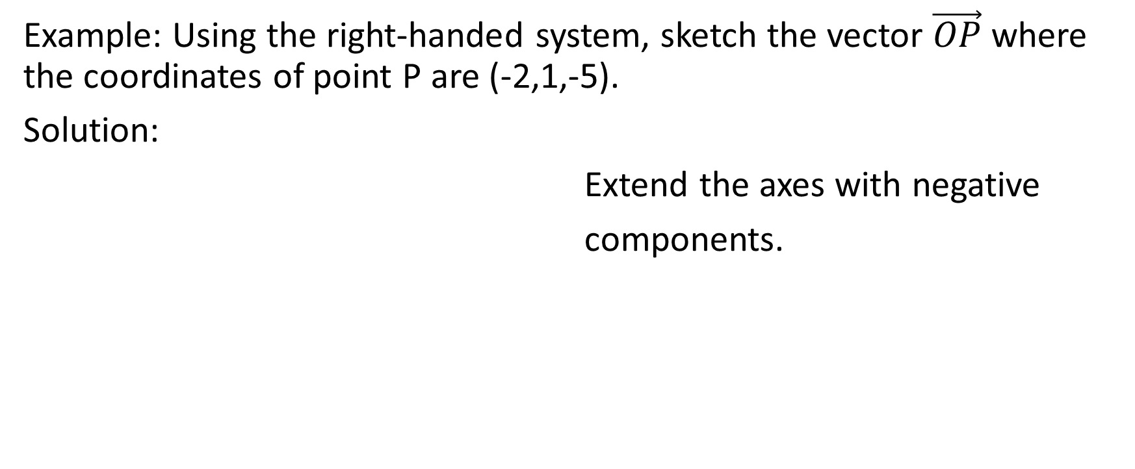
Example: Using the right-handed system, sketch the vector $\vec{OP}$where the coordinates of point P are (-2,1,-5).
Solution:
Extend the axes with negative
components.

Slide 23
Example: Using the right-handed system, sketch the vector $\vec{OP}$where the coordinates of point P are (-2,1,-5).
Solution:

Slide 24


Example: Using the right-handed system, sketch the vector $\vec{OP}$where the coordinates of point P are (-2,1,-5).
Solution:
The vector $\vec{OP}$ is in red.

Slide 25

Example: Using the right-handed system, sketch the vector $\vec{OP}$where the coordinates of point P are (-2,1,-5).
Solution: Determine the coordinates of
the points O, A, B, C, D, E, F, and P

Slide 26

Example: Using the right-handed system, sketch the vector $\vec{OP}$where the coordinates of point P are (-2,1,-5).
Solution:
O (0,0,0)

Slide 27

Example: Using the right-handed system, sketch the vector $\vec{OP}$where the coordinates of point P are (-2,1,-5).
Solution:
O (0,0,0) A (0,0,-5)

Slide 28
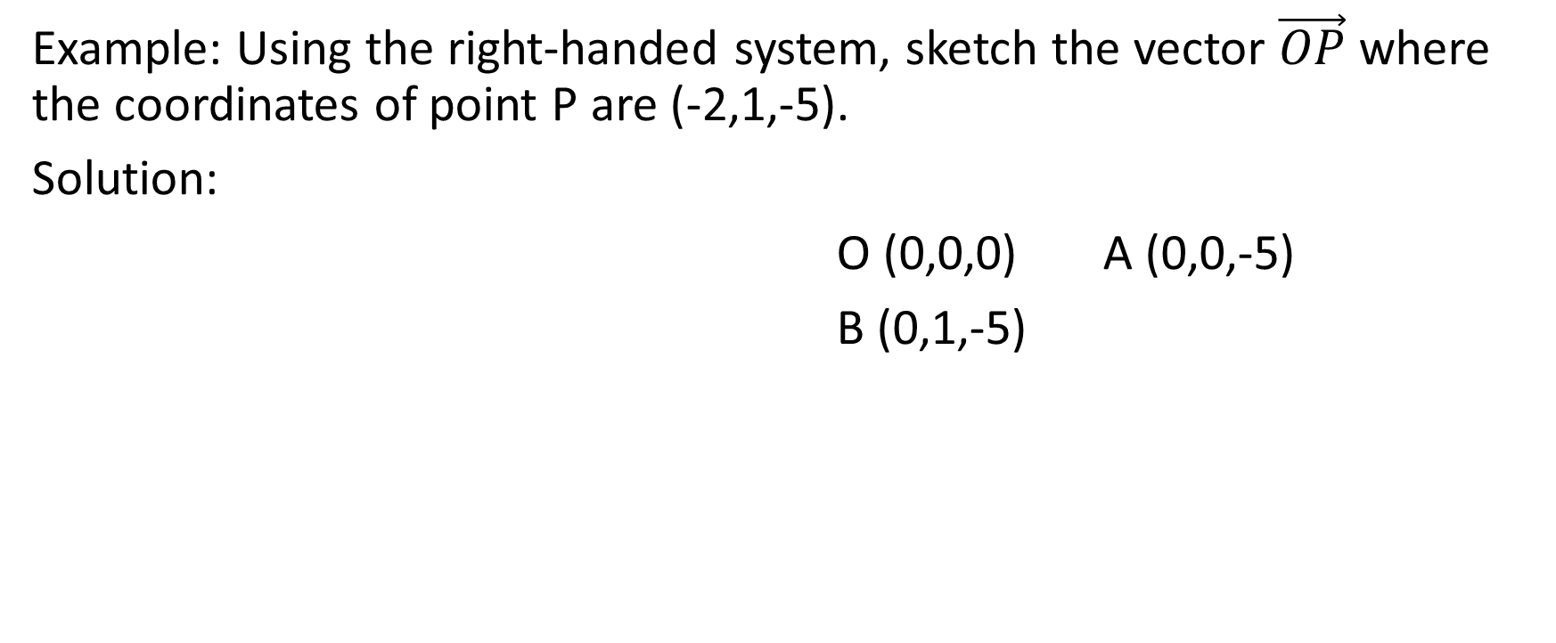
Example: Using the right-handed system, sketch the vector $\vec{OP}$where the coordinates of point P are (-2,1,-5).
Solution:
O (0,0,0) A (0,0,-5)
B (0,1,-5)

Slide 29
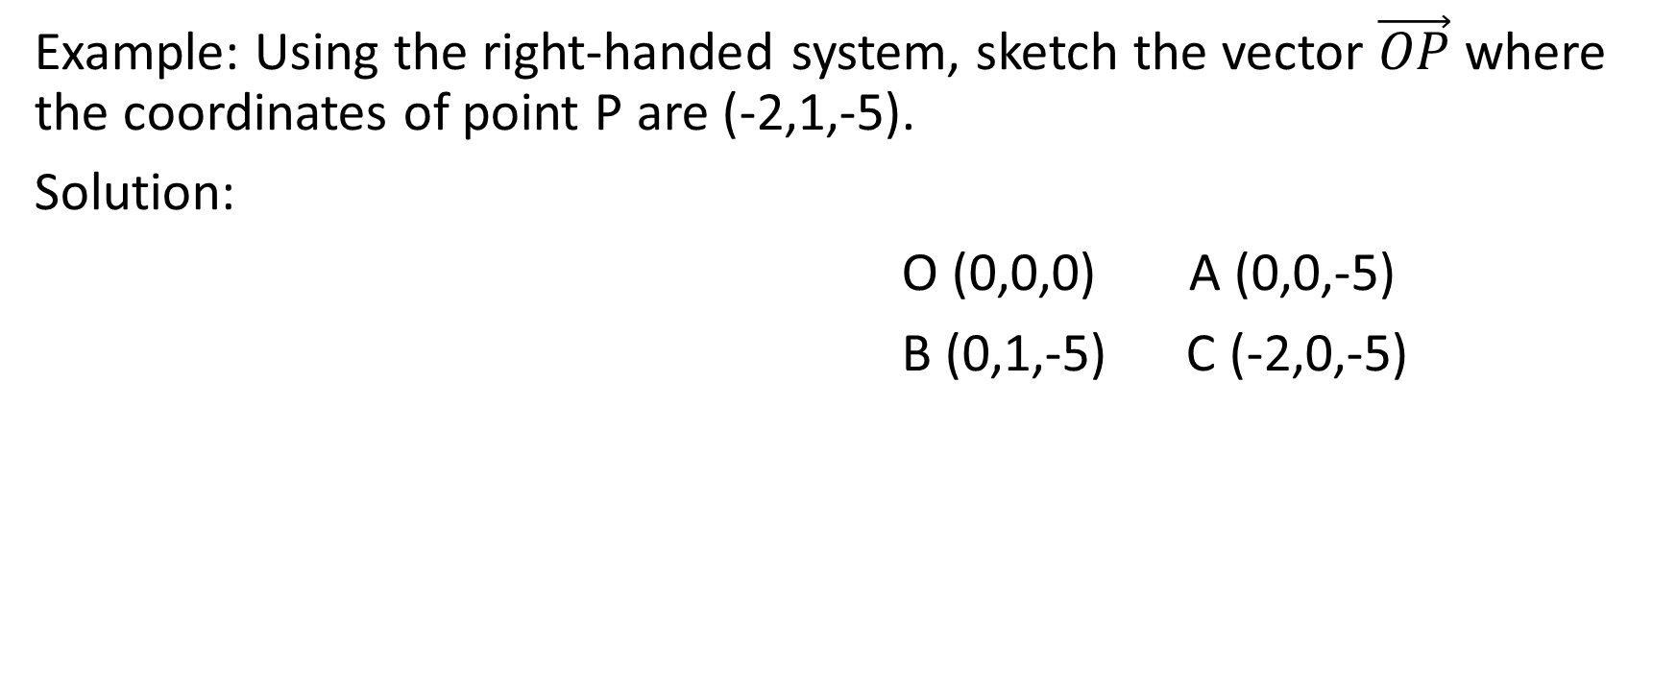
Example: Using the right-handed system, sketch the vector $\vec{OP}$where the coordinates of point P are (-2,1,-5).
Solution:
O (0,0,0) A (0,0,-5)
B (0,1,-5) C (-2,0,-5)

Slide 30
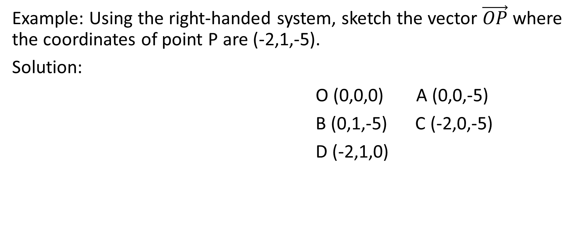
Example: Using the right-handed system, sketch the vector $\vec{OP}$where the coordinates of point P are (-2,1,-5).
Solution:
O (0,0,0) A (0,0,-5)
B (0,1,-5) C (-2,0,-5)
D (-2,1,0)

Slide 31
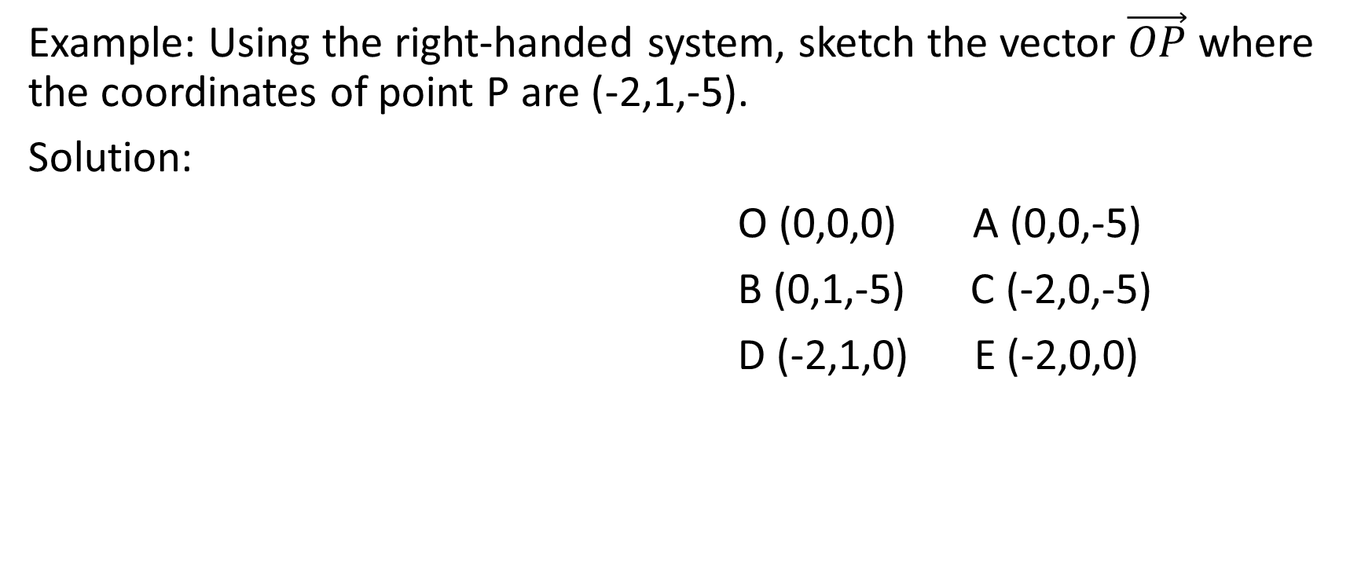
Example: Using the right-handed system, sketch the vector $\vec{OP}$where the coordinates of point P are (-2,1,-5).
Solution:
O (0,0,0) A (0,0,-5)
B (0,1,-5) C (-2,0,-5)
D (-2,1,0) E (-2,0,0)

Slide 32
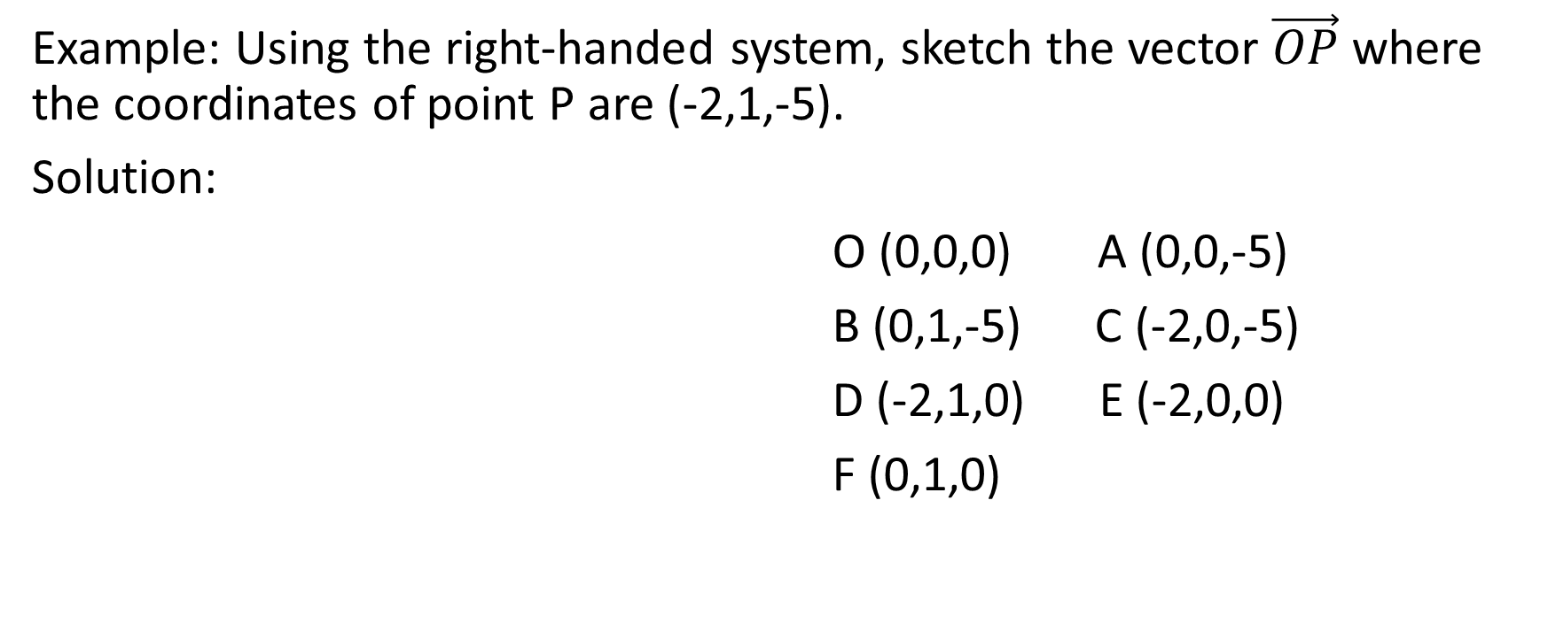
Example: Using the right-handed system, sketch the vector $\vec{OP}$where the coordinates of point P are (-2,1,-5).
Solution:
O (0,0,0) A (0,0,-5)
B (0,1,-5) C (-2,0,-5)
D (-2,1,0) E (-2,0,0)
F (0,1,0)

Slide 33
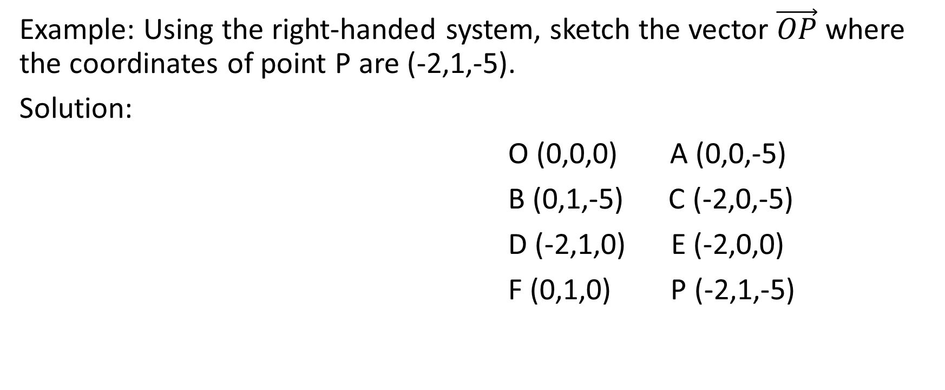
Example: Using the right-handed system, sketch the vector $\vec{OP}$where the coordinates of point P are (-2,1,-5).
Solution:
O (0,0,0) A (0,0,-5)
B (0,1,-5) C (-2,0,-5)
D (-2,1,0) E (-2,0,0)
F (0,1,0) P (-2,1,-5)

